Slide 1

DINING DYNAMICS
J.VINATHI(160122737007)
m. Sai VARSHITHA
(160122737015)
n. Manvika(160122737017

Slide 2
ABSTRACT
Firstly, it seeks to evaluate the prevalence and popularity of online delivery versus offline services among restaurants listed on Zomato, shedding light on evolving consumer behavior and preferences. Secondly, it endeavors to identify the most favored types of restaurants among users, leveraging user interactions, ratings, and reviews to discern culinary preferences and dining experiences preferred by the general public. Lastly, it aims to delve into the realm of dining preferences for couples, investigating preferred price ranges for romantic dinners to provide actionable insights for restaurant owners and marketers targeting this demographic segment.
Additionally, the project dives into the realm of dining dynamics for couples, scrutinizing preferred price ranges for romantic dinners. Utilizing Google Colab or Jupyter Notebook for seamless execution, our analysis promises to offer actionable insights for restaurateurs, diners, and Zomato alike.

Slide 3
PROBLEM STATEMENT, OBJECTIVES AND OUTCOMES
PROBLEM STATEMENT: "Investigating Dining Trends: A Comprehensive Analysis of Zomato Data Using Data Analytics and Visualization“ OBJECTIVES : Determine the proportion of restaurants offering online delivery compared to those providing offline services. Investigate the popularity of different types of restaurants among the general . Analyze the preferred price range for couples dining at restaurants. Rating Distribution and Majority Ratings OUTCOMES: The majority of the restaurants fall into the dining category. Dining restaurants are preferred by a larger number of individuals. This suggests that a majority of the restaurants do not accept online orders. The majority of restaurants received ratings ranging from 3.5 to 4. The majority of couples prefer restaurants with an approximate cost of 300 rupees. Offline orders received lower ratings in comparison to online orders, which obtained excellent ratings.

Slide 4
TECHNOLOGY STACK
Zomato Data Analysis Using Python" embarks on a data-driven exploration of dining preferences and trends through the lens of Zomato's vast repository. Leveraging Python's powerful libraries—
NumPy for efficient computations,
Matplotlib for visualization,
Pandas for data manipulation and
Seaborn for enhanced graphics

Slide 5
MATHEMATICAL ANALYSIS
Descriptive Statistics
Comparative Analysis
Correlation Analysis
Correlation Analysis
Visualization

Slide 6
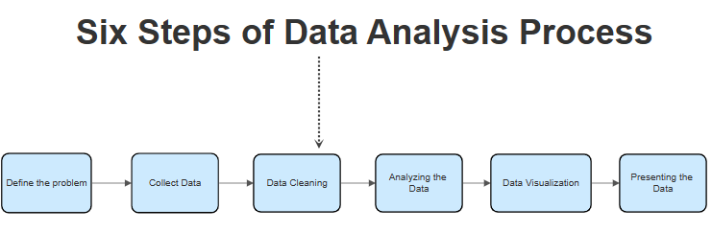
ALGORITHM

Slide 7
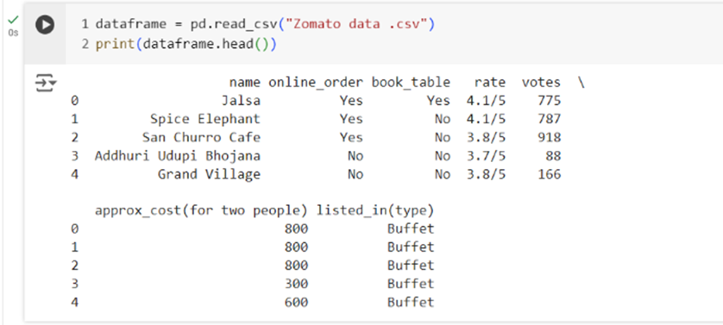
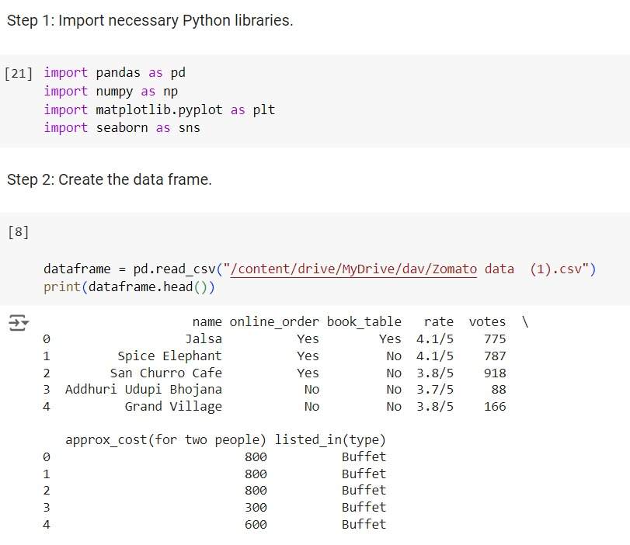
IMPLEMENTATIONS

Slide 8
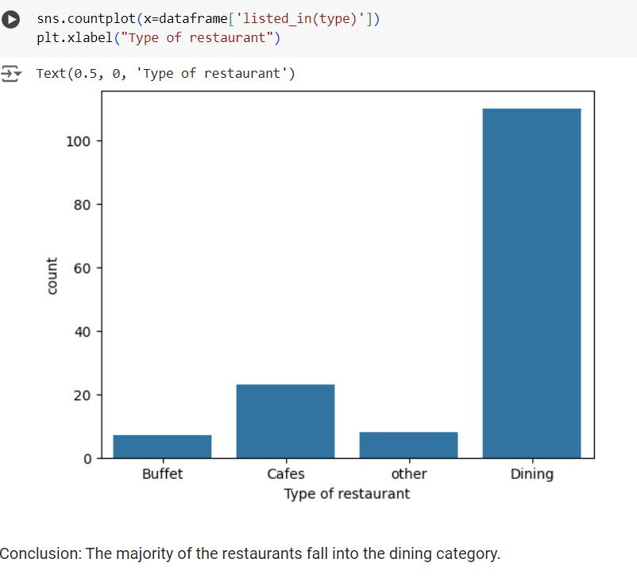
RESULTS

Slide 9
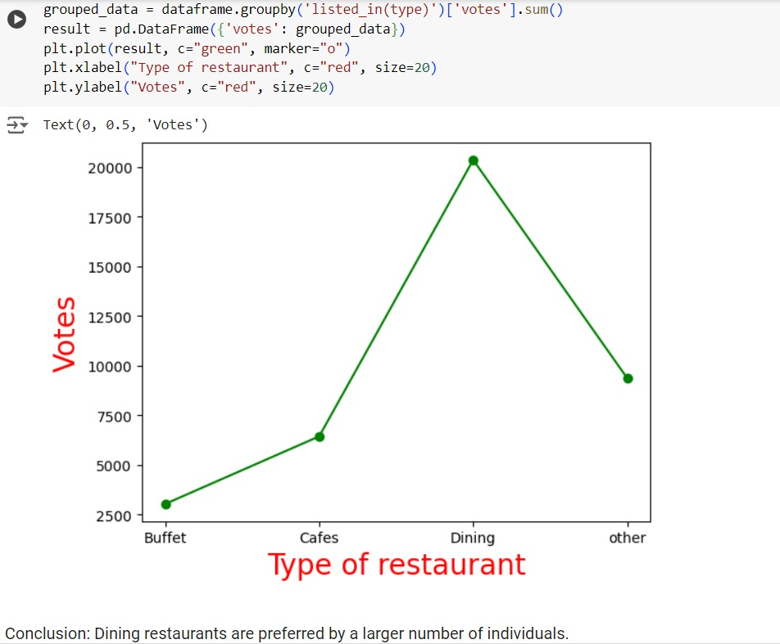

Slide 10
CONCLUSION AND FURTHER STUDY
Overall, Dining Dynamics- "Zomato Data Analysis Using Python" project successfully leverages Python's powerful data analysis libraries to uncover significant insights from Zomato's vast dataset. Our analysis reveals key trends and preferences in the restaurant industry, such as the predominance of online delivery services, the most popular types of restaurants, and the preferred price ranges for couples. Additionally, we identify the common rating ranges, providing a clear picture of customer satisfaction levels. This data-driven approach not only improves customer satisfaction but also drives business growth in the competitive dining landscape.
To further enhance this project, future studies could delve into the regional variations in dining preferences and service offerings, analyzing how geographic and cultural factors influence the prevalence of online delivery versus offline dining. Additionally, examining the impact of demographic variables such as age, income, and lifestyle on restaurant popularity and spending habits could provide more granular insights. Incorporating sentiment analysis of customer reviews and social media mentions could also offer a deeper understanding of consumer satisfaction and preferences.

Slide 11
REFERENCES
Python Libraries:
Requests Library Documentation: This documentation will help you understand how to make HTTP requests to the Zomato API.
Pandas Documentation: Pandas is a powerful library for data manipulation and analysis. The documentation provides detailed explanations and examples.
Matplotlib Documentation: Matplotlib is a popular library for creating visualizations in Python. The documentation covers various plotting functions and customization options.
Seaborn Documentation: Seaborn is built on top of Matplotlib and provides a high-level interface for creating attractive statistical graphics. The documentation includes tutorials and examples.
GitHub Repositories:
Zomato Data Analysis: This GitHub repository contains code for analyzing Zomato restaurant data using Python and various libraries like Pandas, Matplotlib, and Seaborn.
Zomato Data Analysis Project: Another GitHub repository with code for analyzing Zomato data. It includes data cleaning, visualization, and insights.

Slide 12


